Slide 1
Campus Recreation Safety & Risk Management Committee

Slide 2
About Campus Recreation
3 Facilities:
Fike Recreation Center
Douthit
Andy Quattlebaum Outdoor Education Center

Slide 3
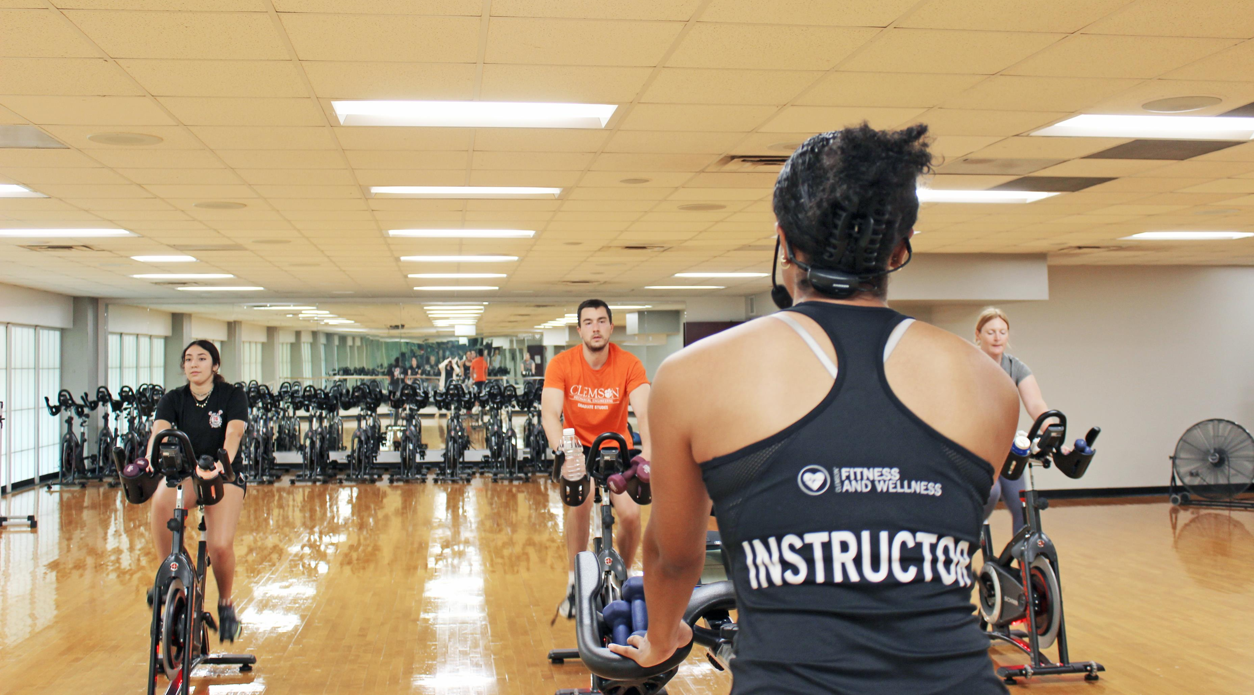
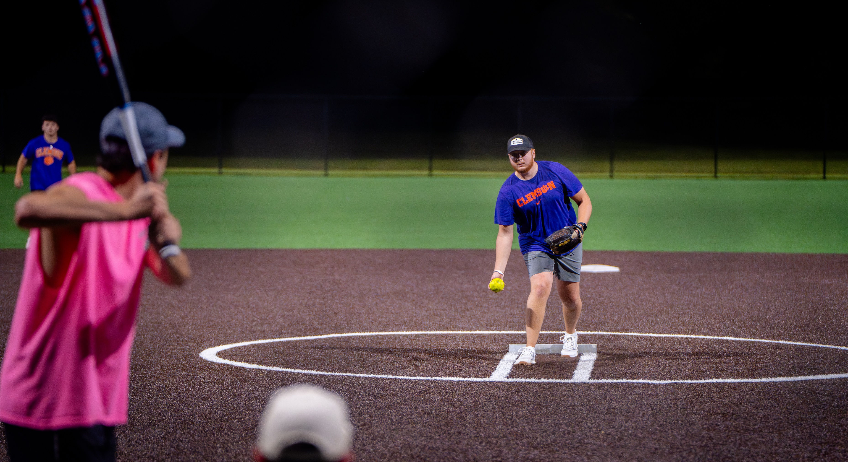
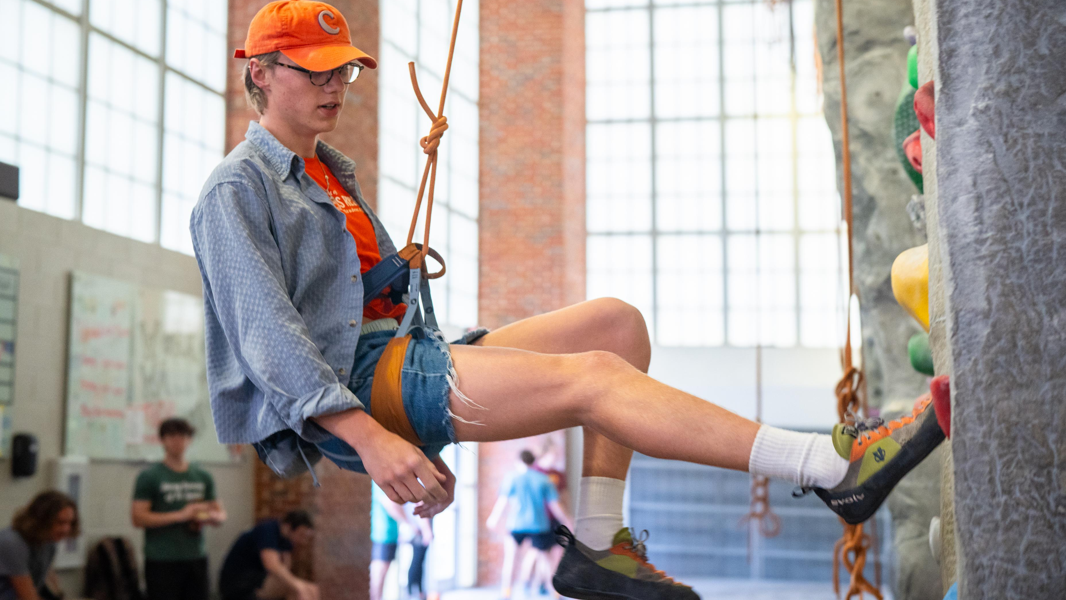
About Campus Recreation
7 different program areas:
Aquatics
Outdoor Recreation
Climbing Wall
Group Fitness
Operations
Sport Programs
Welcome Center
About 380 student-employees

Slide 4
Safety Committee
Compromised of 4 key members
Representation from operations and programming
Meet monthly
“General Assembly” Meetings – open to the entire department

Slide 5
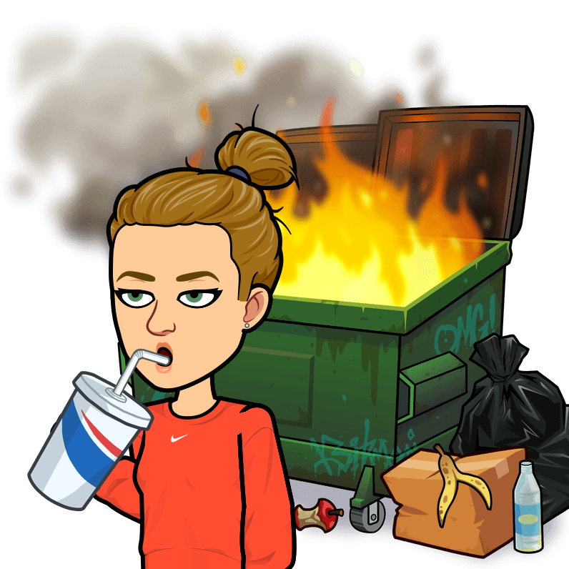
How it started:
How it’s going:

Slide 6
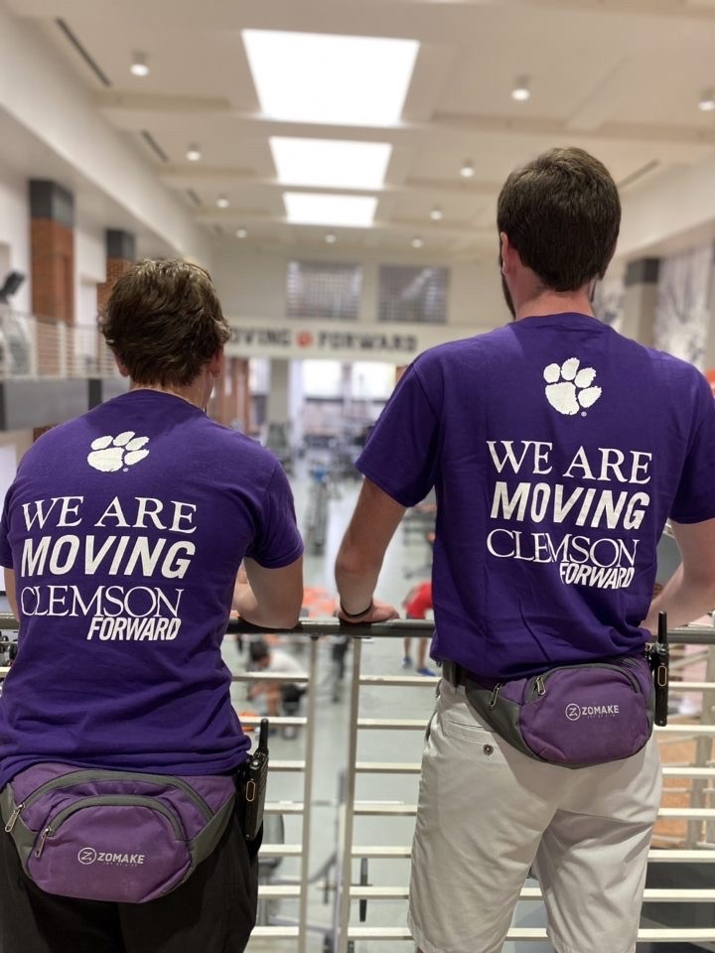
What we’ve done:
Constructed department EAP and other policies
Streamlined accident reporting and analyzed accident data
Utilized Connect2 software to report accidents and inspect safety equipment (AEDs, eye-wash stations, etc.)
Created resources for professional and student-staff to access
Established a culture of safety

Slide 7
More work to do:
Develop more effective strategies to communicate this information to student-staff
Adapt and adjust policies as things change
Prepare and share monthly safety information for all staff
And much more…

Slide 8
Developing a safety committee:
Representation from all areas
Committee makes decisions
Ask questions and get the details
Establish effective form of communication to share safety information

Slide 9
THANK YOU!

